Slide 1
ROCKBUSTER STEALTH STRATEGY
NAME: Ryan Cyril Pares DATE: OCTOBER - 2024

Slide 2

Introduction
Rockbuster Stealth LLC, a global movie rental company, once operated stores worldwide but now faces intense competition from streaming giants like Netflix and Amazon Prime. To remain competitive, the Rockbuster Stealth management team plans to leverage its existing movie licenses by launching an online video rental service.

Slide 3

KEY QUESTIONS
CRITICAL QUESTIONS FOR 2020 STRATEGY
The Rockbuster Stealth Management Board has identified critical questions for their 2020 strategy and seeks data-driven insights to guide their decision-making. The primary questions include:
Which movies had the highest and lowest contributions to revenue gain?
What is the average rental duration for all movies?
Where are Rockbuster's customers located geographically?
Which locations have customers with high lifetime value?
Are there variations in sales across different geographic regions?

Slide 4
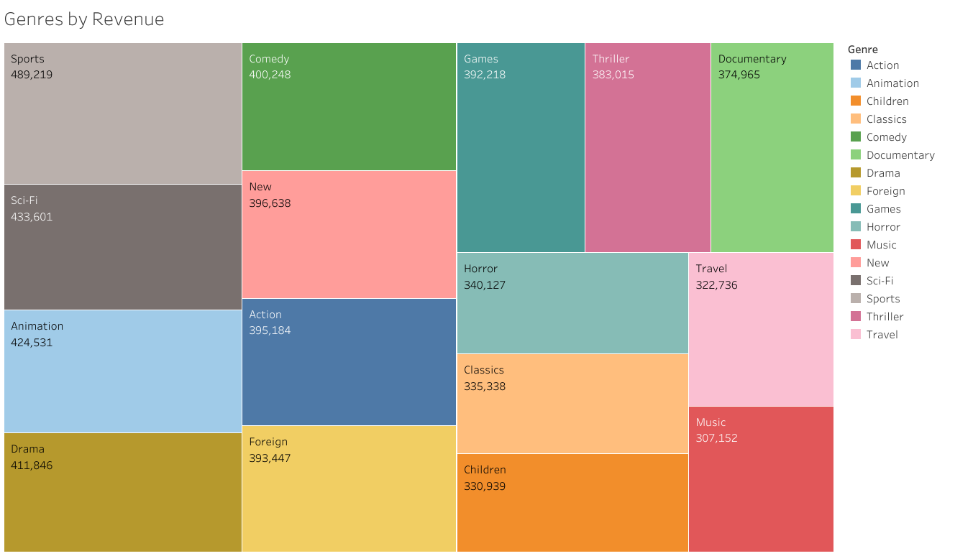

REVENUE CONTRIBUTIONS
Which movies had the highest and lowest contributions to revenue gain?
For Rockbuster, the Sports category is the leading contributor to its business, followed closely by the Sci-Fi, Animation, and Drama categories. These genres form a substantial portion of the company's revenue, with a fairly uniform distribution among them. However, the Thriller genre stands out for its minimal contribution to the overall earnings, significantly less than the other categories.

Slide 5

AVERAGE RENTAL DURATION
Customer Data Summary (Total Customers: 599)
Metric | Rental Duration | Rental Rate
Average | 4.98 days | $2.98
Minimum | 3 days | $0.99
Maximum | 7 days | $4.99
What was the average rental duration for all videos?

Slide 6
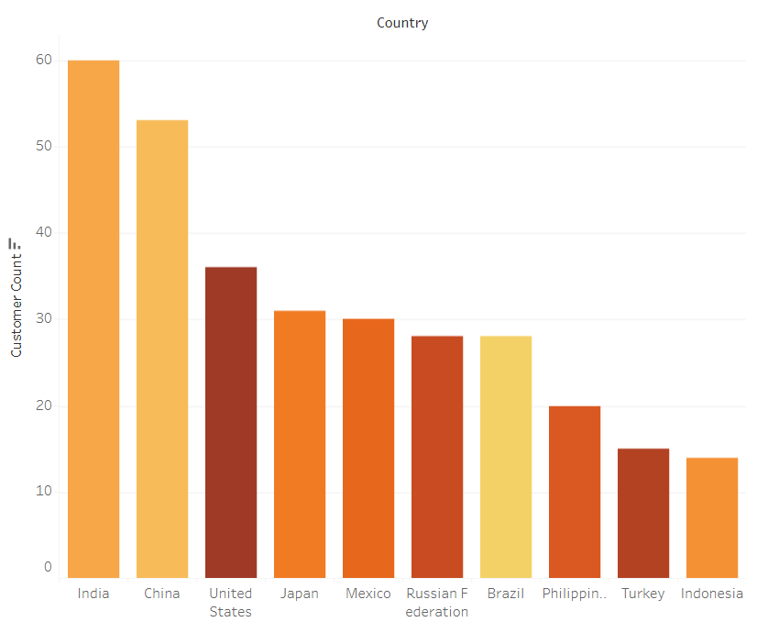
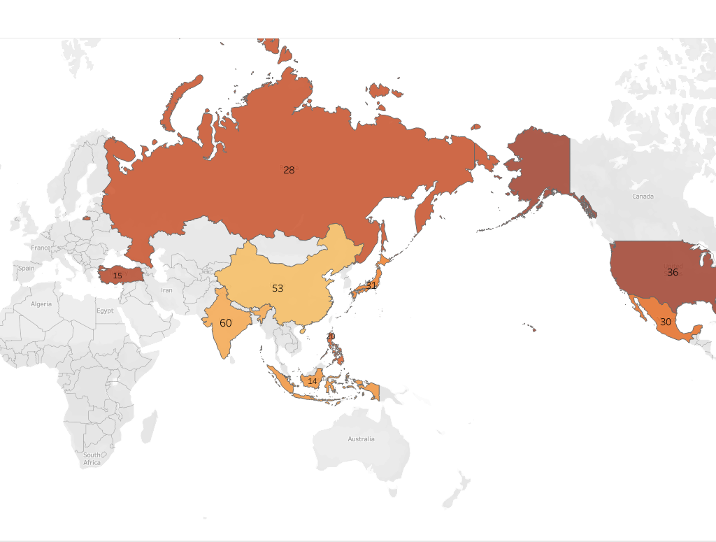
CUSTOMER GEOGRAPHY
Where are Rockbuster's customers located geographically?

Slide 7
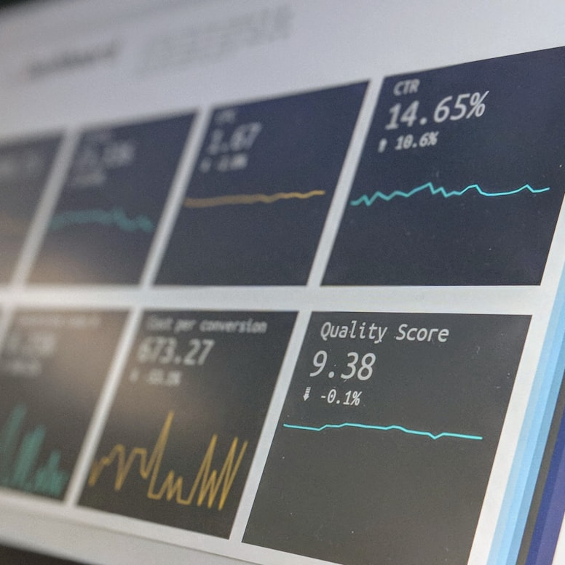

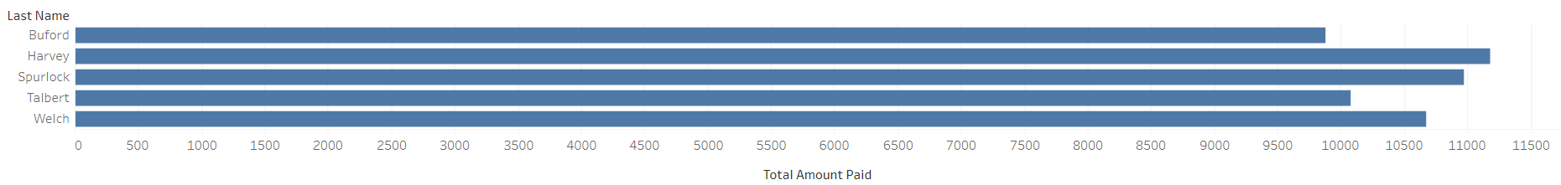
LOCATION ANALYSIS
Which locations have customers with high lifetime value?
India has the largest Customer base followed by China & the US.
Tailoring loyalty programs and exclusive promotions to high-value customers and key cities can unlock significant opportunities. These segments are not only prime for personalization but also provide a perfect setting for Rockbuster to refine its streaming service through targeted enhancements. By delving into the preferences and behaviors of these users, Rockbuster can sharpen its retention tactics, ensuring a steady stream of revenue from its most valuable customers.
Top 5 customers who have paid the highest amounts.

Slide 8
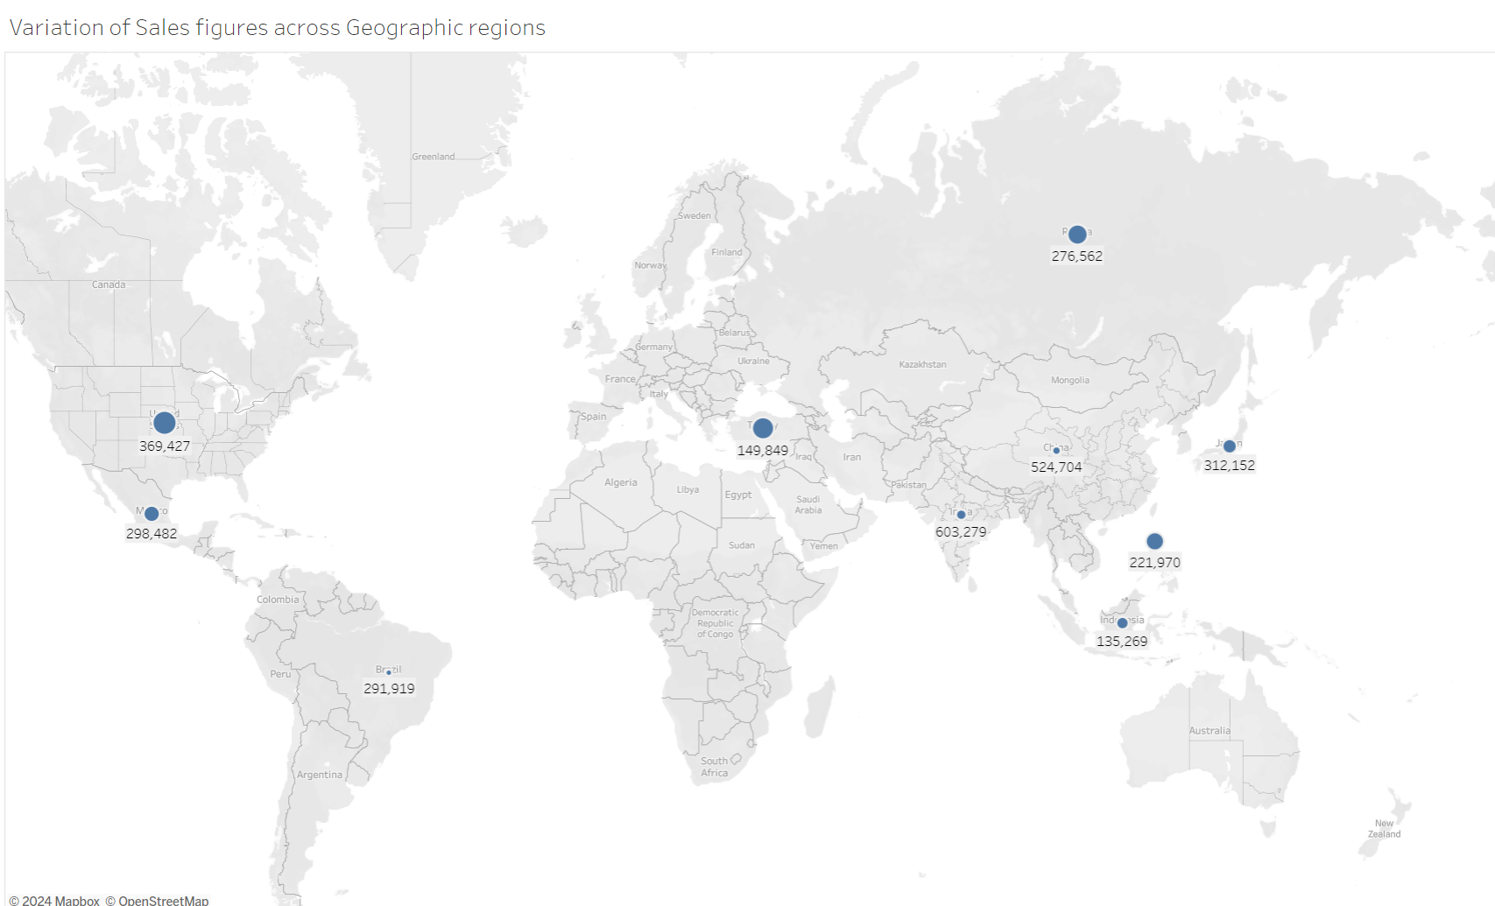
SALES VARIATIONS
Are there variations in sales across different geographic regions?
REGIONAL PERFORMANCE OVERVIEW
Sales vary significantly across regions; understanding these disparities can inform tailored marketing approaches.

Slide 9
Recommendations
1. Rockbuster Stealth is advised to prioritize the Indian, Chinese & United States markets due to their high customer base and significant lifetime value contributions.
2. Films in the genres of sports, science fiction, animation, and drama are noted for their substantial revenue generation, suggesting a strategic focus on these categories for future releases.
3. Further analysis is recommended to identify the viewing preferences of the top revenue-generating customers, allowing for tailored online promotions.
4. The implementation of a rewards system, such as gift codes, could serve as an incentive for loyal customers, offering benefits like discounted movie rates on their online accounts.

Slide 10
Thank You

